Slide 1




Welcome to
CSA2002 INTRODUCTION TO DRONES
G.GANESAN, B.E (CSE)., M.E (CSE)., M.S(IT).,MISTE.,
SENIOR TEACHING FELLOW,
SCHOOL OF CSE.
+91-9500234437
ganesan.g@vitbhopal.ac.in

Slide 2
Course Content
Date: 01-02-2023 Time: 10.05am – 11.35am
1. Building Arduino Based Follow Me Drone
2. GPS Tracker using ESP8266

Slide 3
Building Arduino-based Follow Me Drone

Slide 4
Building Arduino-based Follow Me Drone
Requirements:
Motors
ESCs
Battery
Propellers
Radio-controller
Arduino Nano
HC-05 Blutooth module
GPS
MPU6050 or GY-86 gyroscope
Some wires

Slide 5
Connections
Connect Motors to ESCs and ESCs to Battery. (use 4-way connector)

Slide 6
Connections
2. Connect the Radio to the Arduino Nano
Arduino Pin | Radio Pin
D3 | CH-1
D5 | CH-2
D2 | CH-3
D4 | CH-4
D12 | CH-5
D6 | CH-6

Slide 7
Connections
3. Connect the Gyroscope to the Arduino Nano
Arduino Pin | Gyroscope Pin
5V | 5V
GND | GND
A4 | SDA
A5 | SCL

Slide 8
Connections
4. Connect the Radio to the Arduino Nano
Arduino Pin | Motor Pin
D7 | Motor-1
D8 | Motor-2
D9 | Motor-3
D10 | Motor-4

Slide 9
Connections
5. Connect the Bluetooth to the Arduino Nano
Arduino Pin | Bluetooth Module Pin
TX | RX
RX | TX
5V | 5V
GND | GND

Slide 10
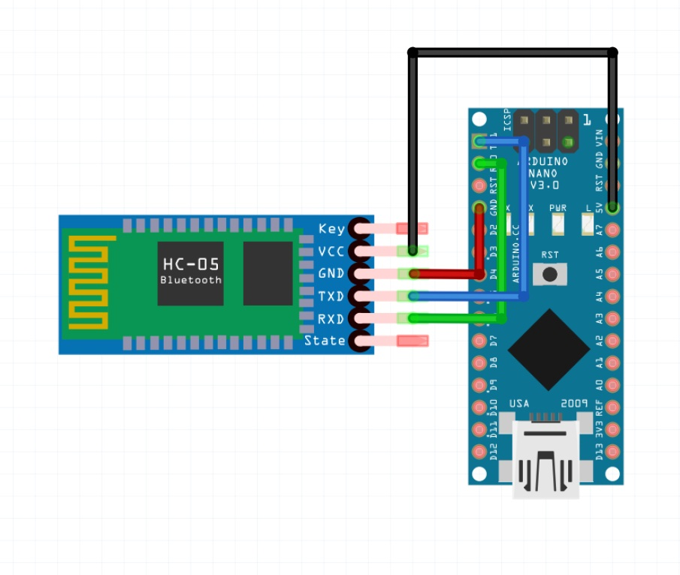

Slide 11
Connections
3. Include the library “PinChangeInt” in Arduino library.
4. Upload the code to Arduino Nano.
5. Connect the GPS with corresponding pin
Arduino Pin | GPS Pin
D11 | TX
D12 | RX
GND | GND

Slide 12
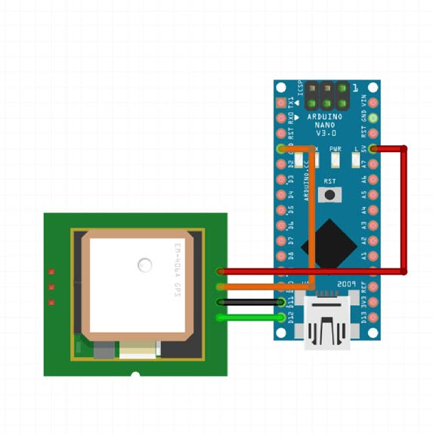

Slide 13
GPS Tracker using ESP8266

Slide 14
GPS Tracker using ESP8266
Requirements:
NodeMCU – It has built-in ESP8266)
GPS receiver
Cables
Battery
Smart Phone (Blynk)

Slide 15
Connection
NodeMCU with GPS Receiver
NodeMCU | GPS Receiver
D1 | TX
D2 | RX
GND | GND
VCC | 3V

Slide 16
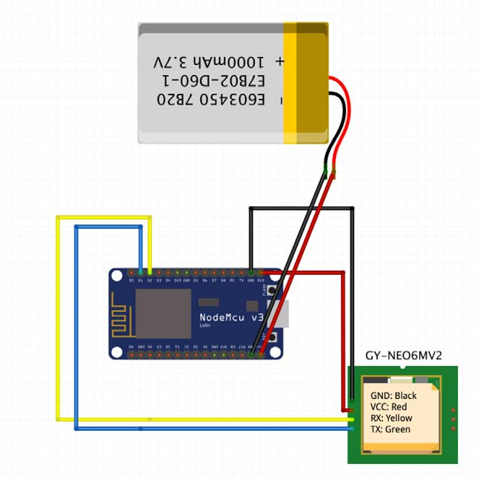

Slide 17
Blynk Application Setup
1. Connect the NodeMCU to the computer.
2. Open the Blynk Application, Create a new project.
3. Preparing the Drone for Flying.
4. Remember the authentication code sent to the email address
registered with the application.
Project Name: MY GPS TRACKER
Device Type: NodeMCU
Connection Type: WiFi

Slide 18
Blynk Application Setup
5. To see the real-time location in text value, add two text fields with
“Labeled Values”.
6. For Latitude, set the pin type “Virtual” and pin “V1”.
7. For Longitude, select pin type “Virtual” and pin “V2”.
8. We can change the text color by tapping the circuit color icon.
9. Add the “Map” from the Widget Menu and Select pin type to be
“Virtual” and pin “V0”.
10. The Blynk application need our permission to use our Phone GPS.
If the GPS turned OFF, then it shows Notification.
If the GPS turned ON, select the “Display Value” or “Labeled
Value” to the screen with “Virtual” and pin “V3”.

Slide 19
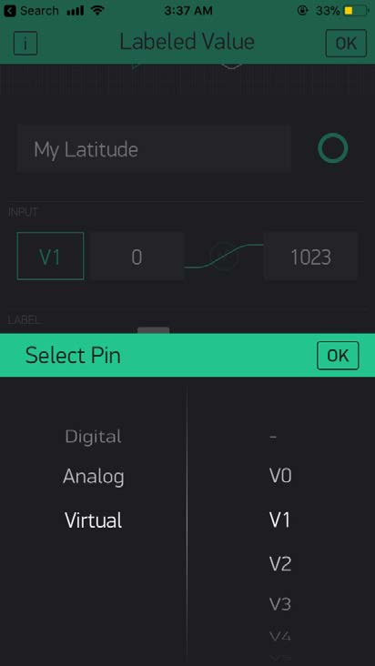
Blynk Application Setup

Slide 20
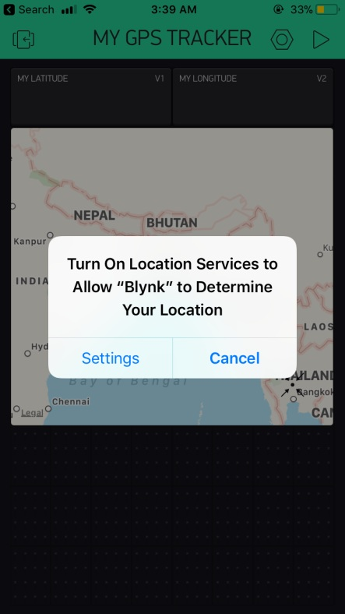
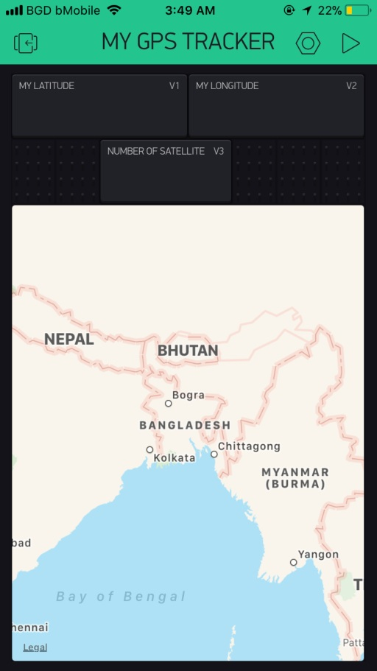
Blynk Application Setup

Slide 21
Blynk Application Setup
Configure the Real-time Location
1. V1 – Set the pin type Virtual for Lattitude.
2. V0 - Add the map from the widget menu and select pin type to be Virtual
3. To see how many satellites
Select a display value or labeled value to the screen with Virtual pin and V3
configuration.

Slide 22
NodeMCU Application Setup
1.Include the Libraries (Download and install in Arduino Software)
#include <TinyGPS++.h>
#include <SoftwareSerial.h>
#include <ESP8266WiFi.h>
#include <BlynkSimpleEsp8266.h>
2. Declare the required variables.
#define BLYNK_PRINT Serial // for Blynk Serial
static const int RX = 4, TX=5; // D1=pin 5, D2=pin 4
Static const uint32_t GPSBaud=9600; // Based on GPS

Slide 23
NodeMCU Application Setup
3. Create an object for the TinyGPS: TinyGPSPlus mygps;
4. Define the pin v0 for the map: WidgetMap mymap(v0)
5. For communication, pass the TX and RX value to the “SoftwareSerial”
SoftwareSerial test_GPS(RX, TX);
6. Declare the Blynk timer and the number of satellites:
BlynkTimer timer;
float noofsats;
7. Define the authentication and WiFi connection:
char auth[] = “ * * * * * * * *”; // send to your mail
char ssid[] = “ * * * * * * * *” // WiFi name
char pass[] = “ * * * * * * * * “ // WiFi password

Slide 24
NodeMCU Application Setup
8. Write the code in
void setup()
{
// Blynk Connection
// GPS checking
}
void loop()
{
// Display Latitude and Longitude
// Display No.of Satellite in Blynk
}
9. Upload the code to NodeMCU after connecting it to the computer.

Slide 25
Thank You
&
Queries?

